Slide 1
Fraud Detection: Logistic Regression
By:
Emmanuel Popoola

Slide 2
Table of Contents
Introduction and Model Assumptions
General EDA
Data Distribution and Skewness
Outliers
EDA for Regression
Data Transformation
Model Implementation
Conclusion

Slide 3
01
Introduction and Model Assumptions

Slide 4
What is Logistic Regression?
Logistic regression is a classification algorithm used to model the relationship between one or more independent variables and a binary or multi-class target variable.

Slide 5
Assumptions
Predictors must relate linearly to log-odds of target variable.
Independent variables shouldn't be highly correlated.
Data must be free from strong outliers.
Observations must be independent.
Response variable should be binary (e.g., Yes/No).
Requires a sufficiently large dataset.

Slide 6
02
General EDA

Slide 7

Data Structure
Inspected the structure of the data using the .info() features to check data types, column names, and target null values. Given data:
-
No missing values - Four categorical columns - Three numerical columns

Slide 8
Data Structure
Column names updated:
.str.replace() with "_" to replace each space for ease of callability
Used the .unique() for the target variable (‘Fraudulent’) to make sure it was binary
Checked for duplicates: .duplicated()
Found none.
Class Imbalance: Target variable 'Fraudulent' is imbalanced (700 non-fraudulent, 300 fraudulent cases).​

Slide 9
03
Data Distribution and Skewness

Slide 10
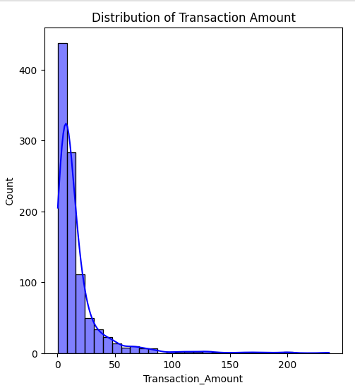
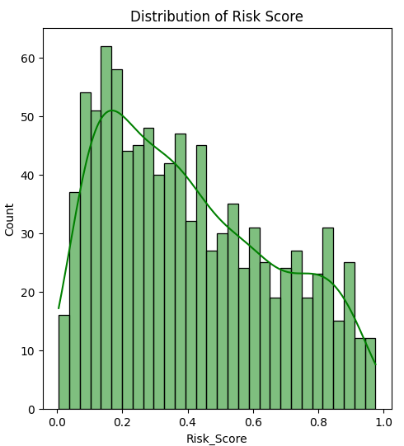

Slide 11
Skewness Analysis: 'Transaction_Amount' (4.38) and 'Fraudulent' (0.87) are positively skewed, exceeding the 0.5 threshold, while 'Risk_Score' (0.45) is less skewed.
Distribution Observation: Fig. show clustering at lower values, with fewer higher values, causing positive skewness in 'Transaction_Amounts' and 'Risk_Score'.
Impact on Model: Positive skewness can lead to biased predictions, underfitting minority classes or overfitting majority classes.

Slide 12
04
Outliers

Slide 13
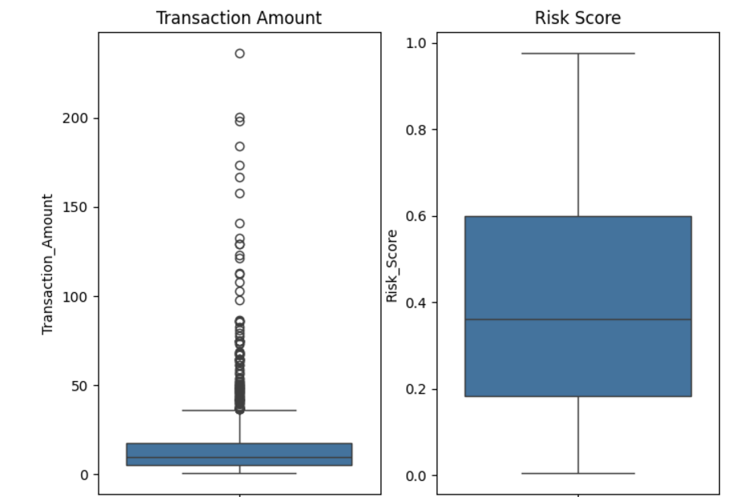
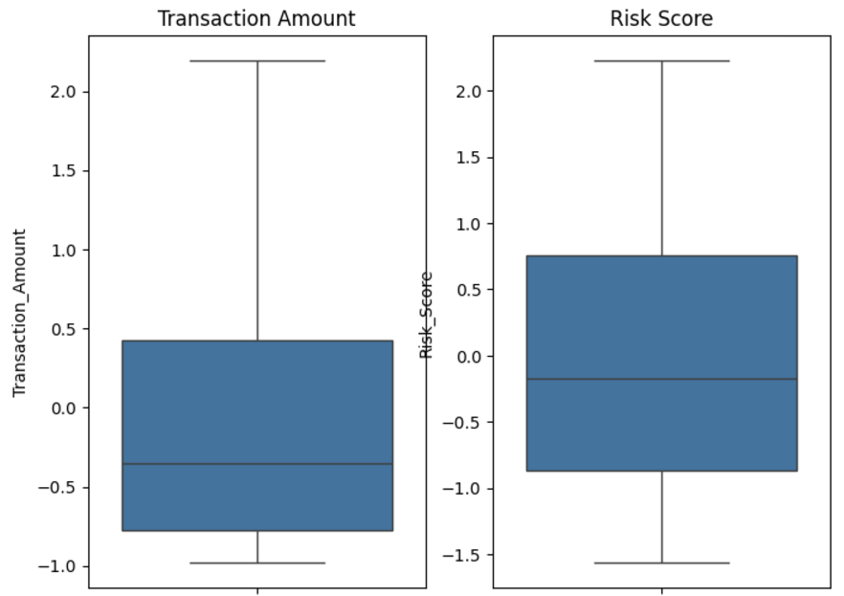
Outlier Detection and Winsorization: Boxplots revealed outliers in 'Transaction_Amount', which were mitigated using Winsorization (threshold = 0.1) to cap extreme values while preserving dataset variability.
Result: Winsorization reduced the impact of outliers, satisfying the assumption of no extreme outliers for better model performance.
Before Winsorization
After Winsorization

Slide 14
05
EDA for Regression

Slide 15
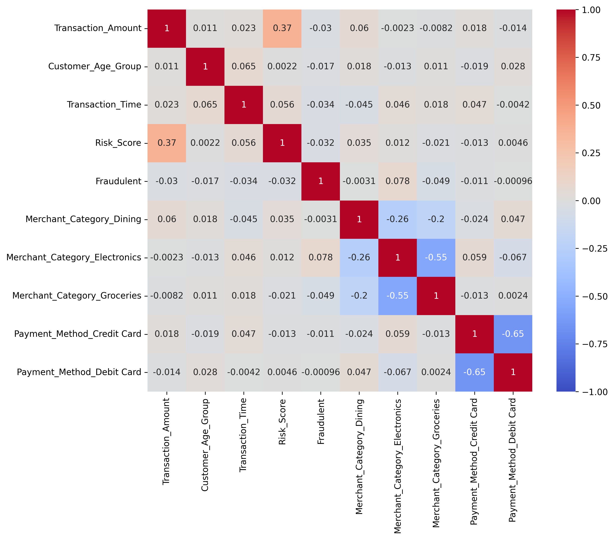
Multicollinearity and Independence of Observation Assumption
Correlation Analysis: Moderate positive correlation (0.37) between 'Transaction_Amount' and 'Risk_Score'; no multicollinearity detected (VIF < 5).
Independence Check: Chi-square test (p = 0.287) confirms categorical variables are independent, meeting the independence assumption.

Slide 16
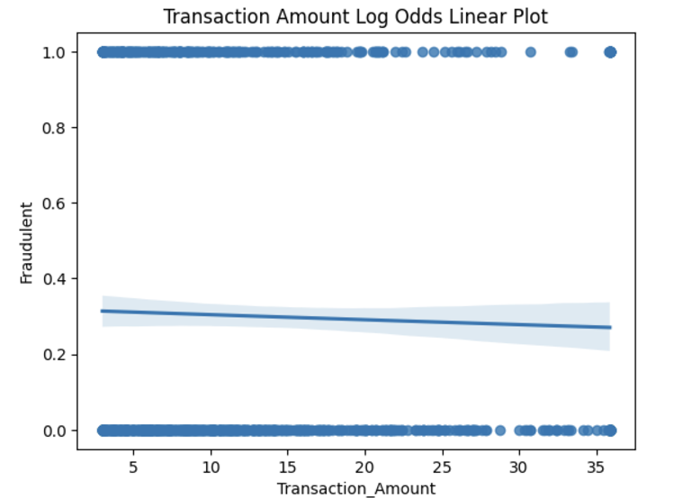
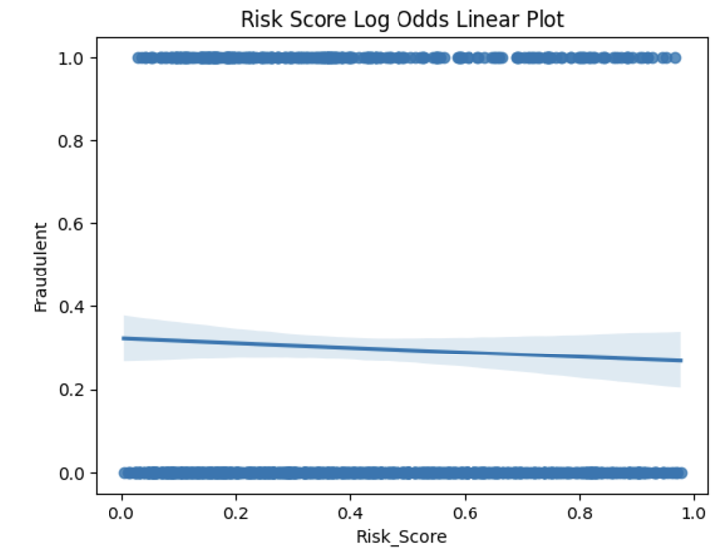
Linearity Assumption
The Logistic Curve is not shown as a S shape. It implies non-linearity and complexities in the data violate the linearity assumption.

Slide 17
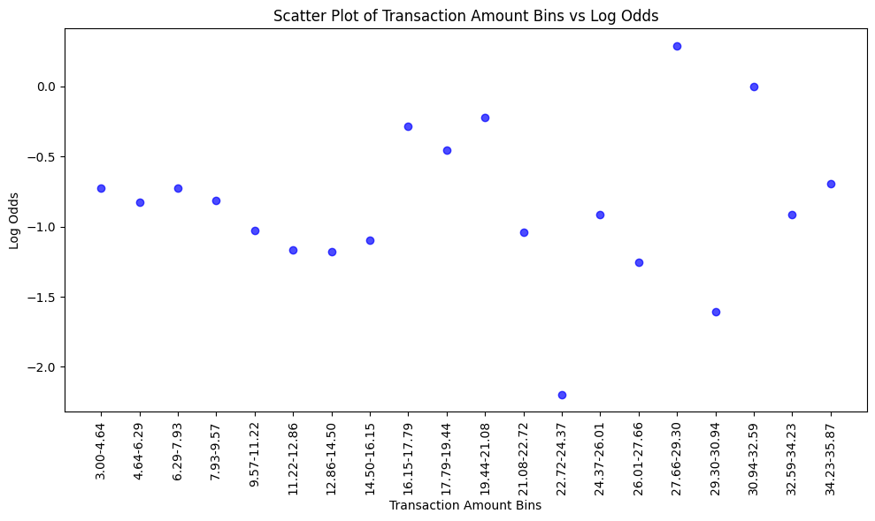
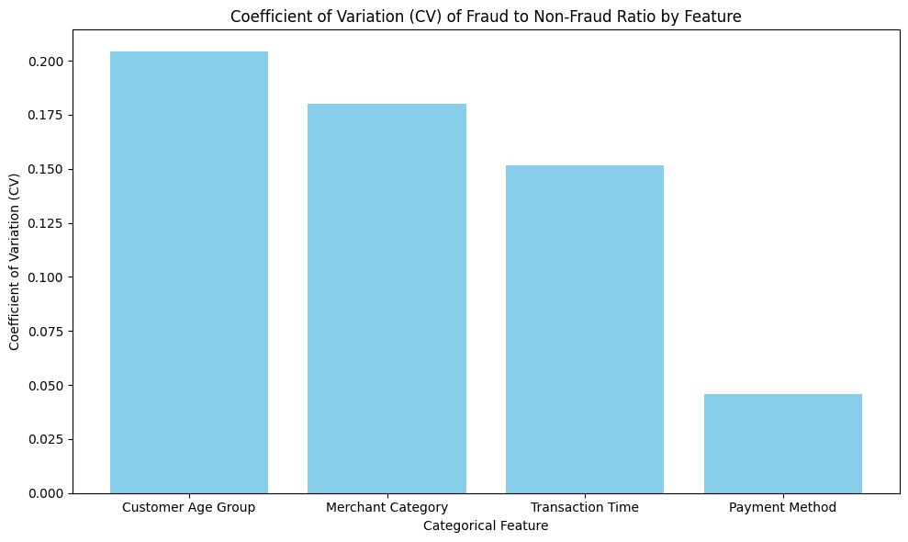
Linearity Assumption
There is no clear correlation between numerical features and the log odds of the target, as the plots scatter randomly.
Categorical features with high variability, like Customer Age Group (CV = 0.2041) and Merchant Category (CV = 0.1800), are key for fraud prediction due to their strong differentiation. While low-variability features like Payment Method (CV = 0.0459) may complement other predictors.

Slide 18
06
Data Transformation

Slide 19
Dummy Variable
Used label encoding for ordinal data ('Customer_Age_Group', 'Transaction_Time') and one-hot encoding for nominal data ('Payment_Method', 'Merchant_Category').
SMOTE Oversampling
Normalisation
Balanced 'Fraudulent' classes by generating 266 synthetic samples, avoiding overfitting and data leakage.
Scaled numerical columns using StandardScaler(); skewed data adjusted for stable coefficients.

Slide 20
07
Model Implementation

Slide 21
Data Split: 80% training, 20% testing for balanced model training and testing.
AIC Score: The model's AIC of 411.26 indicates a poor fit and suggests low precision and accuracy.

Slide 22
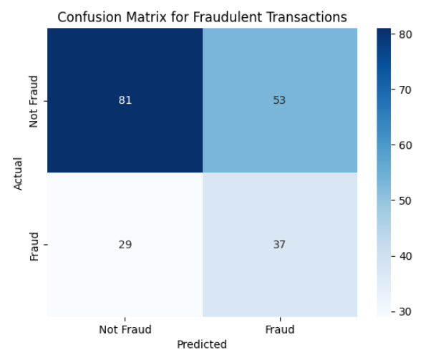
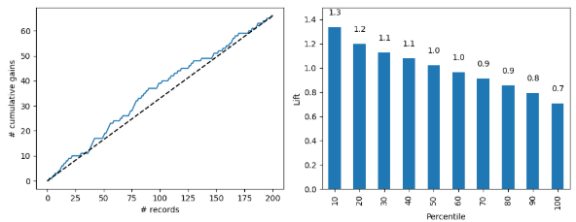
Performance Evaluation: Precision score of 41%, with SMOTE improving performance; confusion matrix shows 81 true positives and 37 true negatives. Gains charts indicate poor model performance.
Evaluation of Model Performance

Slide 23
08
Conclusion

Slide 24
In conclusion, the model’s poor performance can be attributed to two unmet assumptions.
The independence of observations was violated, as there was a moderate correlation of 0.37 between numerical predictors.
The linearity assumption was not met, as the logistic curve deviated from the expected S-shape, indicating a non-linear relationship between the predictors and the target variable.

Slide 25
THANK YOU!

